Slide 1
TBCSA X Trevor Noah
6 November 2023 - 29 February 2024

Slide 2
KEY CAMPAIGN DELIVERABLES

Slide 3
DIGITAL MEDIA CHANNELS
RATIONALE & BUDGET SPLIT

Slide 4
DIGITAL MEDIA CHANNEL RATIONALE
Facebook & IG yield the highest reach & frq within the targeted markets (USA, UK & Germany). These channels are bought as one to ensure optimum media efficiencies.
Audience size within the Travel & related category is 134M + (USA: 91.5M ; UK: 25.6M ; Germany: 16.9M)
X (Formally known as Twitter) is a high impact conversational platform allowing us to tap into tactical conversations related to Travel
Audience size within the Travel category is 12M +
(USA: 5.7M ; UK: 3.6M ; Germany: 2.7M)
TikTok is the fastest growing social media platform in the world. Combining reach, entertainment & high engagement into one channel
Audience size within the Travel category is 178M + (USA: 135M ; UK: 23M ; Germany: 20.6M)
Leverage the power of the Google Display & Video network to drive unique reach across display, amplifying our campaign through awareness & education across key travel and related websites aligned to our audience’s online behaviour
Audience size within the Travel category: 1B+
(USA: 500M ; UK: 280M ; Germany: 220M)
Drive high impact storytelling through a video first platform, enabling us to deliver the highest video completion rates of our Brand advert
Audience size within the Travel category is 374M+ (USA: 246M ; UK: 57.1M ; Germany: 70.9M)

Slide 5
DIGITAL MEDIA CHANNEL
Market | Channel
USA | Facebook and Instagram
UK | Facebook and Instagram
GERMANY | Facebook and Instagram
USA | Programmatic - Google Display + Video
UK | Programmatic - Google Display + Video
GERMANY | Programmatic - Google Display + Video
USA | YouTube (Beta - Video Reach Efficient mix)
UK | YouTube (Beta - Video Reach Efficient mix)
GERMANY | YouTube (Beta - Video Reach Efficient mix)
USA | Twitter (X)
UK | Twitter (X)
GERMANY | Twitter (X)
USA | TikTok
UK | TikTok
GERMANY | TikTok

Slide 6
MEDIA ROLL OUT PLAN + DIGITAL CAMPAIGN MANAGEMENT
Digital Media Management | 23 Oct-30 Oct | 31 Oct-5 Nov | 6 Nov-13 Nov | 14 Nov-21 Nov | 22 Nov-29 Nov | 30 Nov-7 Dec | 8 Dec-15 Dec | 16 Dec-23 Dec | 24 Dec-31 Dec | 1 Jan-7 Jan | 8 Jan-15 Jan | 16 Jan-23 Jan | 24 Jan-31 Jan | 1 Feb-7 Feb | 8 Feb-15 Feb | 16 Feb-23 Feb | 24 Feb-29 Feb
Phase 1
Media Channel Reservation (Meta + Google)
Media Campaign shell Set-up (Incl - Budgeting, Targeting etc)
Media Creative upload (All channels)
Proof of Flighting
Phase 2
Daily Campaign management monitoring
Weekly budget pacing
Weekly FB & IG optimisations
Weekly Display & Video optimisations
Weekly YouTube optimisations
Weekly Twitter optimisations
Weekly TikTok optimisations
Bi-weekly reporting (High-Level)
Monthly in-depth reporting

Slide 7
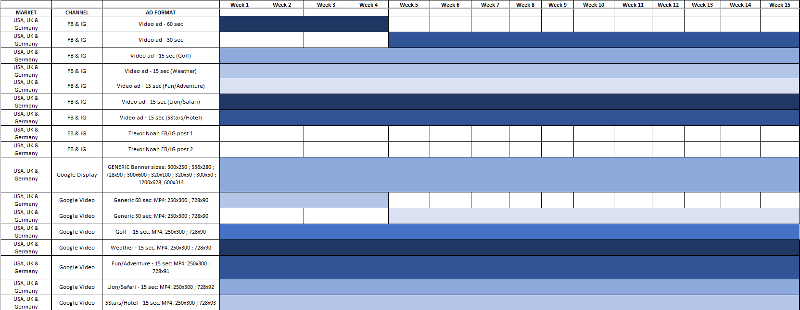
MEDIA ROLL OUT - DIGITAL CREATIVE ASSETS

Slide 8
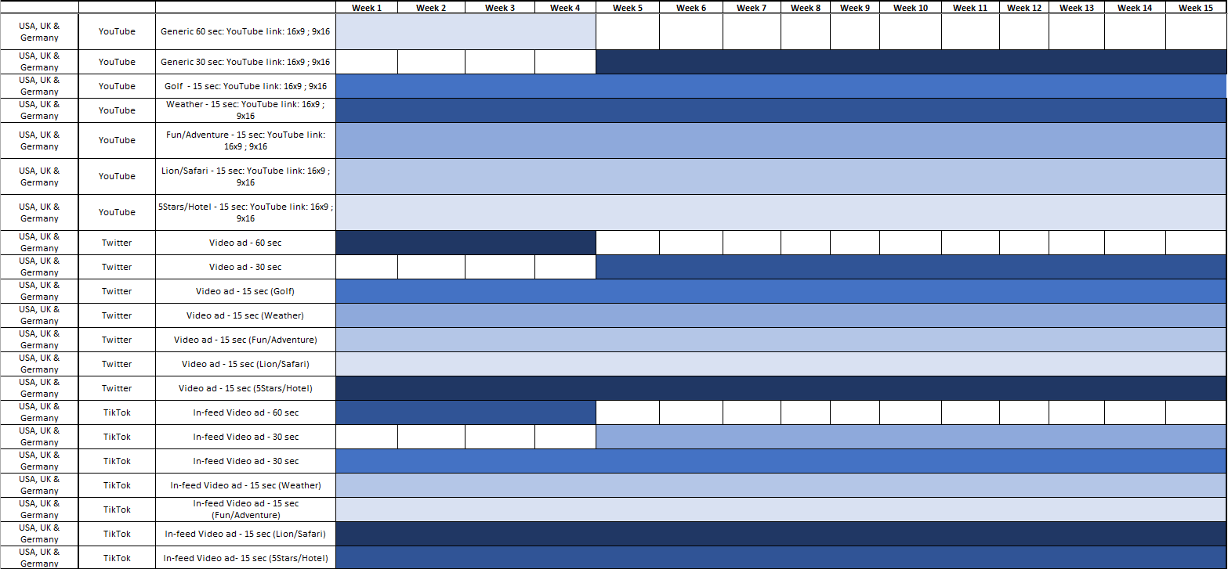
MEDIA ROLL OUT - DIGITAL CREATIVE ASSETS

Slide 9
DIGITAL TARGETING (GENERIC)
DEMOGRAPHIC
AFFINITY & IN-MARKET
CONTEXTUAL
CUSTOM
Travel & related websites, Tourism websites, Travel & related mobile apps, Travel & related Youtube channels, Travel & related Topics
Search terms: Travel to SA, Trips to SA, Family vacations, Top tourist destinations, Affordable travel, Flights to SA, Cape Town Hotels, Kruger national park, Safari destinations, The big 5, Flights to Africa, Hotels in Africa, SA Vacation packages, Long-haul flights, Long-haul flight destinations etc.
Travel, Luxury travelers, Beach bound enthusiasts, Water sport enthusiasts, Family holidayers, Nightlife enthusiasts, Business travel, Travel buffs, Trips to SA, Trips to Africa, Vacation Packages, Honeymoon destinations
Age: 21+
Location: USA, UK & Germany
Language: English
Parental status: All + unknown
Marital status: All + unknown

Slide 10
DIGITAL TARGETING
(GOLF + ADVENTURE/FUN)
DEMOGRAPHIC
AFFINITY & IN-MARKET
CONTEXTUAL
CUSTOM
Golf
Sports enthusiasts, Golf players, Golf clubs, high-end sports, Golf tournaments, Golf in SA, Golf in Africa, Sports activities in Africa, Sports activities in Africa, Sports clubs in SA, Africa sports clubs, Outdoor sports
Age: 21+
Location: USA, UK & Germany
Language: English
Parental status: All + unknown
Marital status: All + unknown
Adventure/Fun
Outdoor activities, Sports activities, Watersport activities, Paragliding, Hiking, River rafting, Hot air balloons, Shark cage diving, Wine tasting, Cycling, Adventure travel, Outdoor travel, International adventure travel, Watersports clubs, Surfing in SA, Surfing in Africa, Surf clubs, Bungee jumping in SA, Bungee jumping Africa, Wine tasting Cape town, Winelands Cape Town, Adventure in SA

Slide 11
DIGITAL TARGETING
(WEATHER + LION/SAFARI)
DEMOGRAPHIC
AFFINITY & IN-MARKET
CONTEXTUAL
CUSTOM
Weather
Weather in sa, weather in Africa, hot regions in SA, best time to visit SA, summer months in SA, Best country in Africa, Warmest country in Africa, Africa summer months, South Africa summer months, South Africa spring and summer months][
Age: 21+
Location: USA, UK & Germany
Language: English
Parental status: All + unknown
Marital status: All + unknown
Lion/Safari
Lions in Africa, Safari destinations, Safari travel, Kruger national Park, The big 5, Top Safari destinations, Krugerpark hotels, Krugerpark packages, Safari packages, Family safari holidays, Family vacations, Luxury tents, National parks in Africa, National parks in SA, Game reserves, Game reserves Africa, Wildlife in SA, Wildlife in Africa, Conservation parks, Conservation destinations

Slide 12
DIGITAL TARGETING
(5STARS/HOTELS)
DEMOGRAPHIC
AFFINITY & IN-MARKET
CONTEXTUAL
CUSTOM
5Stars/Hotels
Age: 21+
Location: USA, UK & Germany
Language: English
Parental status: All + unknown
Marital status: All + unknown
5star hotels in SA, 5star hotels in Cape Town, Cape Town hotels, Cape Town packages, Travel Packages to SA, Affordable 5star hotels, Best hotels in SA, Luxury hotels in Africa, Luxury hotels in SA, Luxury resorts in SA, Luxury resorts in Africa, Kid friendly hotels in SA, 5Star resorts in Africa, 5Star resorts in SA, Family hotels in SA, 5Star Kruger national park hotels, 5Star Kruger park packages

Slide 13
TREVOR NOAH ADVERT AMPLIFICATION
PR PRESENTATION

Slide 14
TO DO LIST
Unpacking the chapters of Expression
Defining the moments of Expression
Role out Plan
Budget

Slide 15
AMPLIFICATION OBJECTIVES
Be Seen
Create Demand
Be heard
Be meaningful

Slide 16
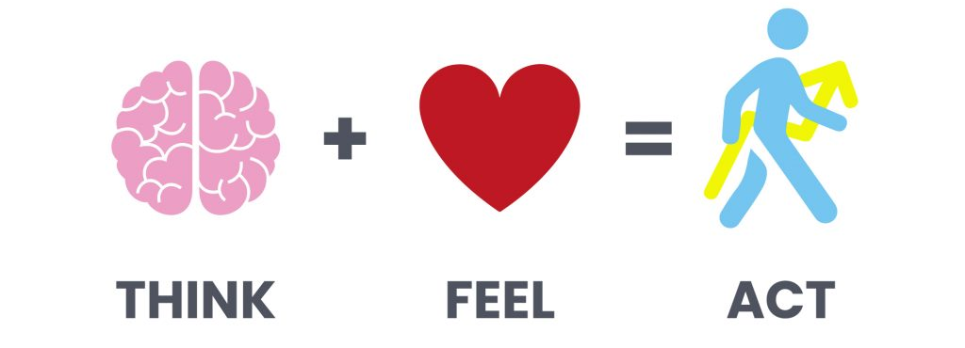
USING SIMPLES APPROACH
Get our potential visitors to think differently about us than they used to. Shift the way they rationalise about us by engagement them behind sentiment
While connecting emotionally with them. Our sentiment and connection needs to tap into their passion points and subculture that allow them to see themselves in us
Ultimately we need to make sure we drive them to act on their thoughts and feeling by considering, enquiring or booking a ticket to SA

Slide 17
HOW DO WE BRING THESE TO LIFE
MOMENTS OF EXPRESSION

Slide 18
PR ROLLOUT PHASES:
1
2
3
LAUNCH
DRIVE ENGAGEMENT
EXCITE & EDUCATE
Drive awareness and connect with audience
Build trust through affiliation and convert/ create consideration
Drive strong education of South Africa & excite through touch points
Meaning
Salience
Salience
Media Launch Event
Media engagement & thought leadership
Media & influencer drops

Slide 19
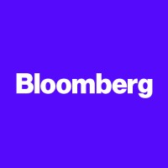
MEDIA PLAN:
FOREIGN CORRESPONDENTS & LOCAL MEDIA

Slide 20
PR ROLLOUT PHASES:
1
LAUNCH - NOVEMBER
Drive awareness and connect with audience
Media Launch Event

Slide 21
LAUNCHING THE ADVERT
ADVOCACY LENS: THINK & FEEL

Slide 22
THE RATIONALE:
The launch event is not just an event; it's a celebration of the greatest of the destination. It is to create an immersive and exciting experience of South Africa that will captivate and inspire foreign media representatives, influencers, and potential travellers. This event aims to generate buzz around South Africa as a must-visit destination, leveraging Trevor Noah's charm and wit. To showcase the magnificence of South Africa to the USA, UK, and Germany markets, we present…

Slide 23
EVENT THEME:
THE BEST OF US

Slide 24
The Best of Us and More," encapsulates the idea that South Africa offers more than what meets the eye. Beyond its stunning landscapes, wildlife, and traditions, South Africa has a vibrant cultural tapestry, culinary diversity, adventure activities, and warm hospitality. The event will seek to bring these aspects to life through various means - from cultural performances and tasting sessions to adventure demonstrations and informative presentations.
Culinary experiences
Cultural exploration
Music exploration
And more…

Slide 25
RUNNING ORDER
ILLUSTRATION

Slide 26
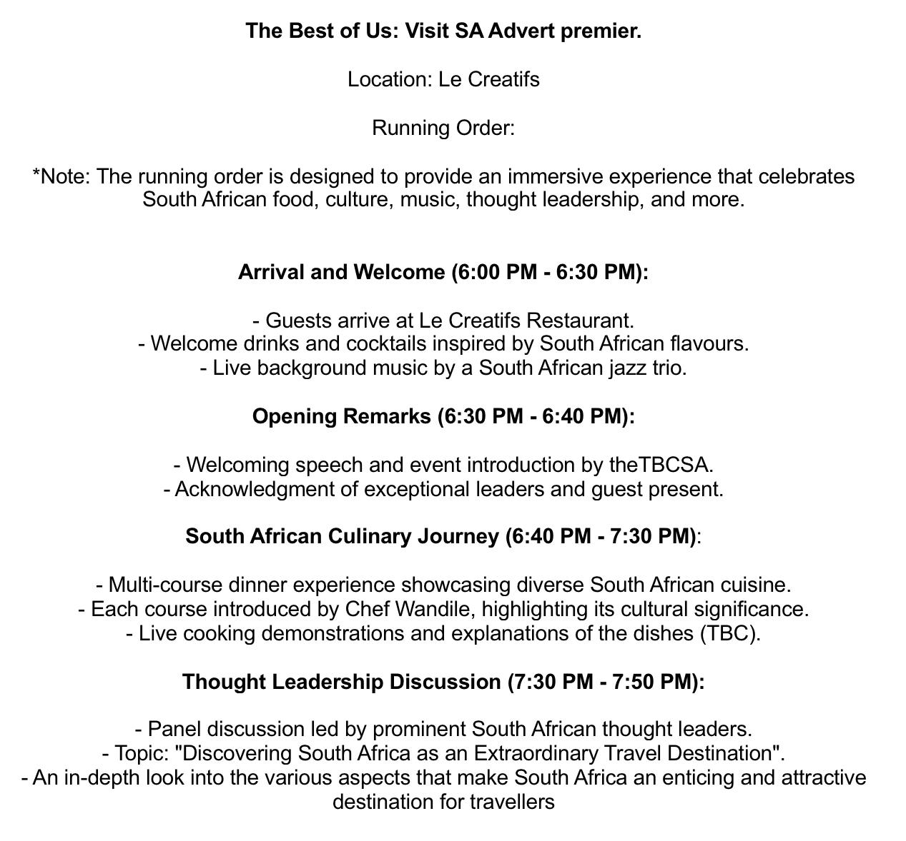

Slide 27
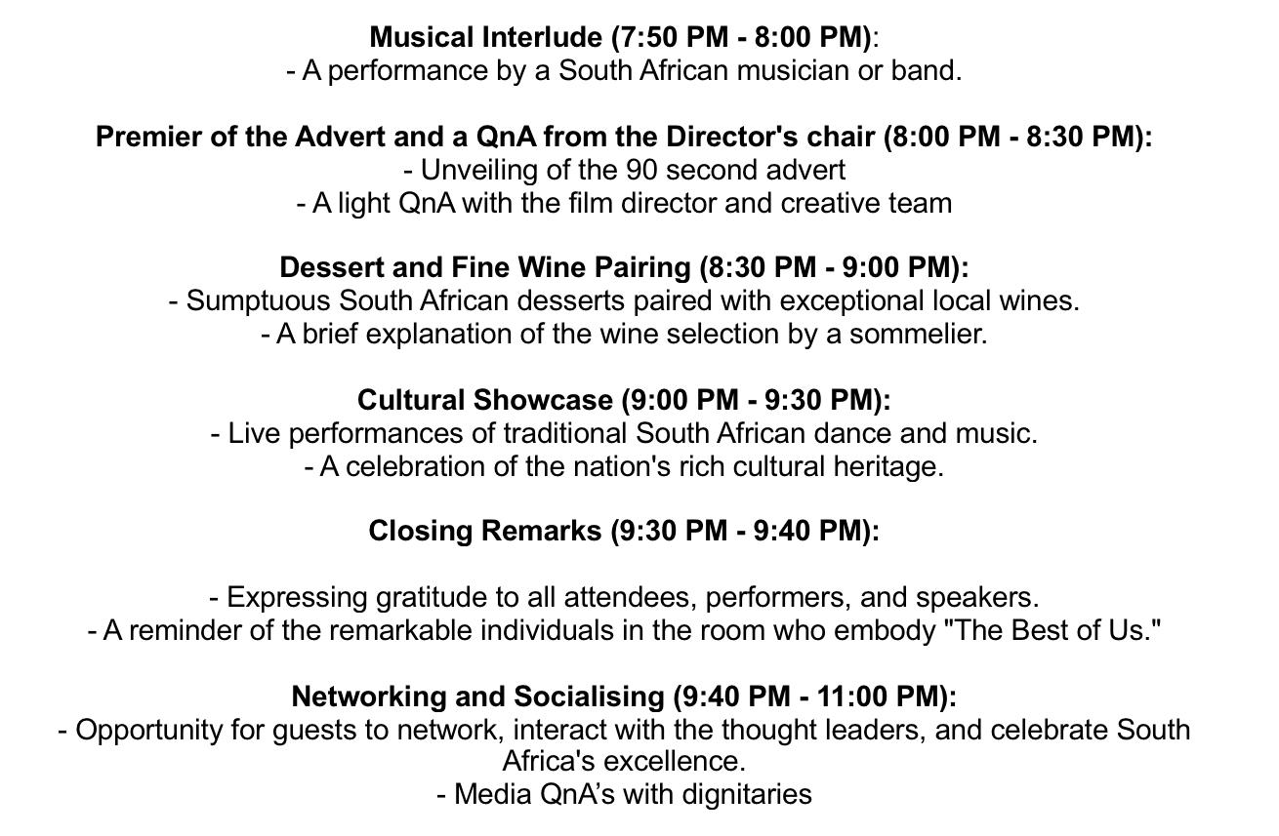

Slide 28
PR ROLLOUT PHASES:
2
DRIVE ENGAGEMENT
NOV - DEC
Build trust through affiliation and convert/ create consideration
Traditional media push

Slide 29
DRIVE ENGAGEMENT
TRADITIONAL MEDIA OUTLOOK

Slide 30
MEDIA KIT RATIONALE
A media kit is an essential tool in traditional public relations (PR) work. It serves as a comprehensive package of information and resources that enables organisations to effectively communicate their message to the media and the public. The rationale behind a media kit in traditional PR is to provide journalists, bloggers, and other media professionals with the necessary assets and information to cover a story accurately and effectively. It helps create a consistent and positive narrative while streamlining the communication process.

Slide 31
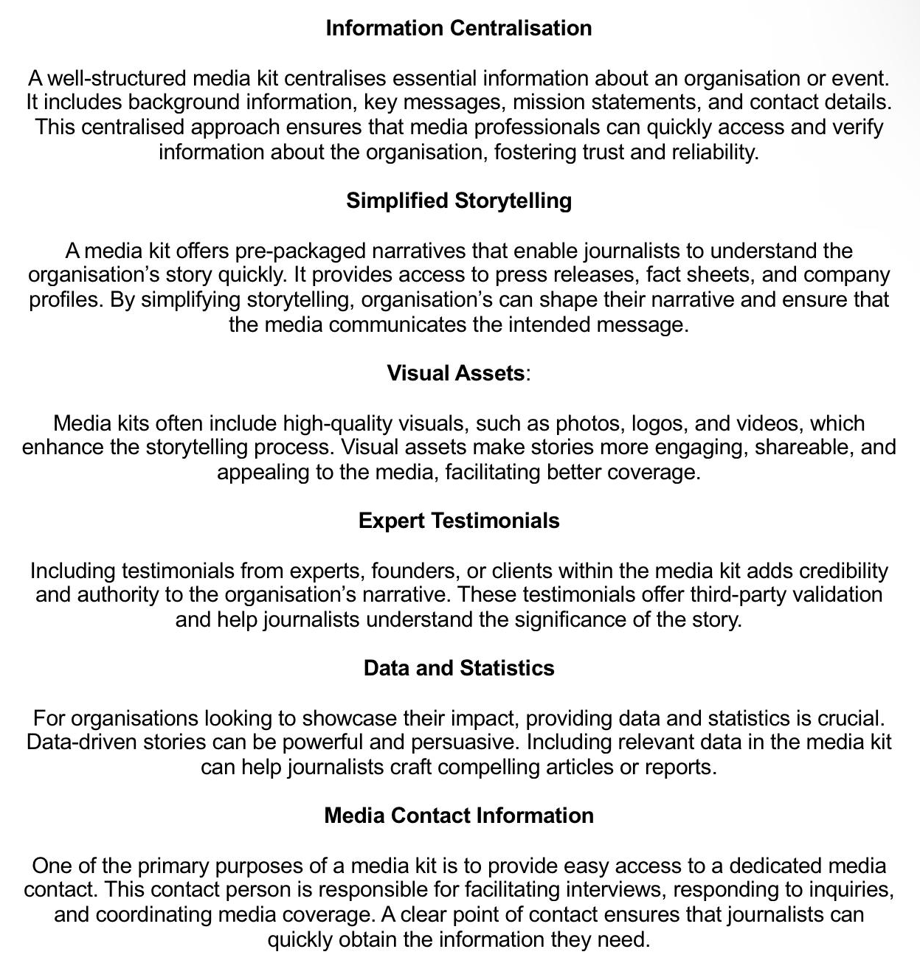

Slide 32
HOW IT WORKS
The media kit will be shared with all our partners, both local and within the market, to enhance the advertising efforts for South Africa. The purpose of this toolkit is to empower in-market teams, including product managers, South African Tourism representatives, tour operators, and government entities, to effectively communicate about South Africa by utilising the Ad as a point of entry. This comprehensive kit will serve as a valuable resource for these teams, enabling them to convey the essence and attractions of South Africa to a global audience, ultimately driving successful marketing and promotion efforts for the country.

Slide 33
PR ROLLOUT PHASES:
3
EXCITE & EDUCATE
JAN - FEB
Drive strong education of South Africa & excite through touch points

Slide 34
EXCITE AND EDUCATE
Excite through touch points

Slide 35
THE MEDIA DROP RATIONALE
The "Best of Us" media drop serves as a vital companion to our in-market toolkit, acting as a catalyst for meaningful conversations centred around our content. It has been meticulously designed to complement the themes presented in the advertisement, while delving deeper into the enchanting narrative of South Africa. we aim to not only deepen the connection people have with South Africa but also to spark engaging conversations that resonate with the diverse and vibrant character of this remarkable nation.

Slide 36
SOUTH AFRICA IN A BOX:
THE BEST OF US MEDIA DROP
South Africa is a country that captures the hearts of all who experience it. The essence of the nation is filled with a unique blend of diversity, culture, resilience, and natural beauty. The idea behind the "+27, 27 Things to Love About South Africa" media drop is to provide a tangible and immersive experience that encapsulates the spirit of South Africa and highlights what makes it truly exceptional.

Slide 37
WHAT’S IN THE BOX?
SOME OF THE KEY THINGS TO EXCITE THE MARKET

Slide 38
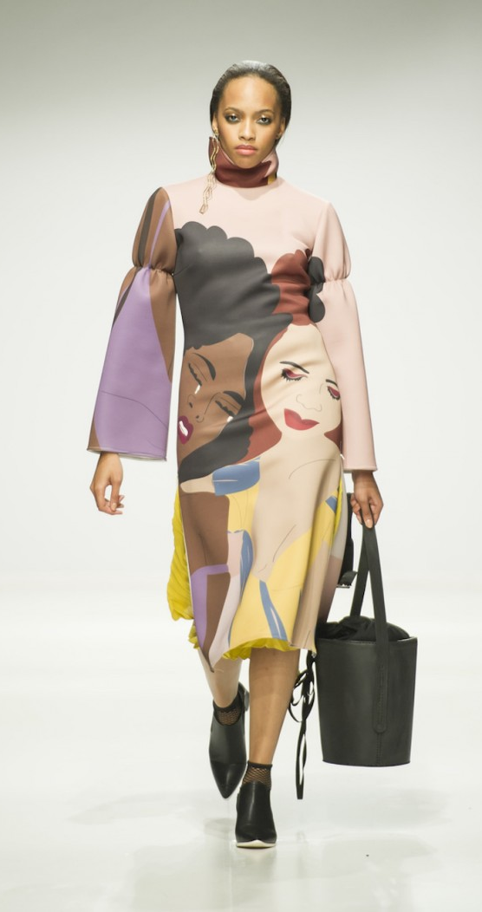
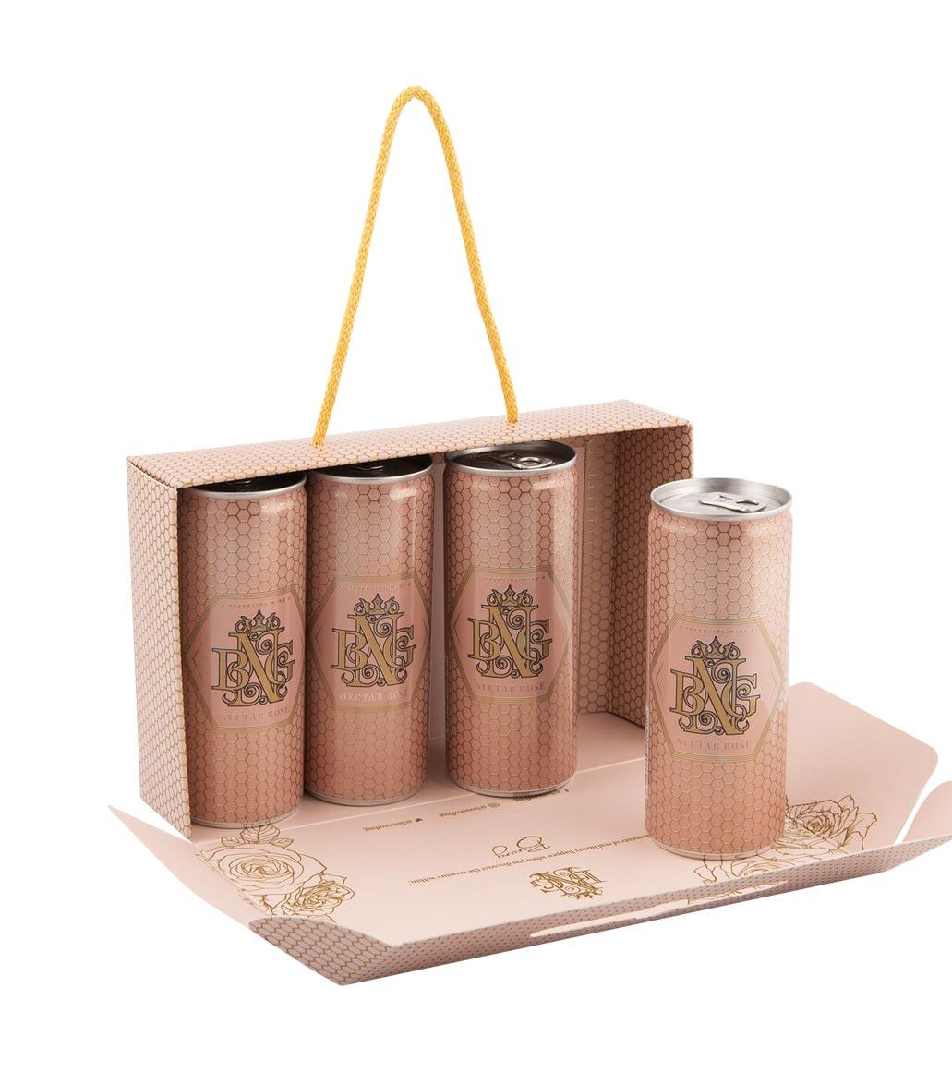
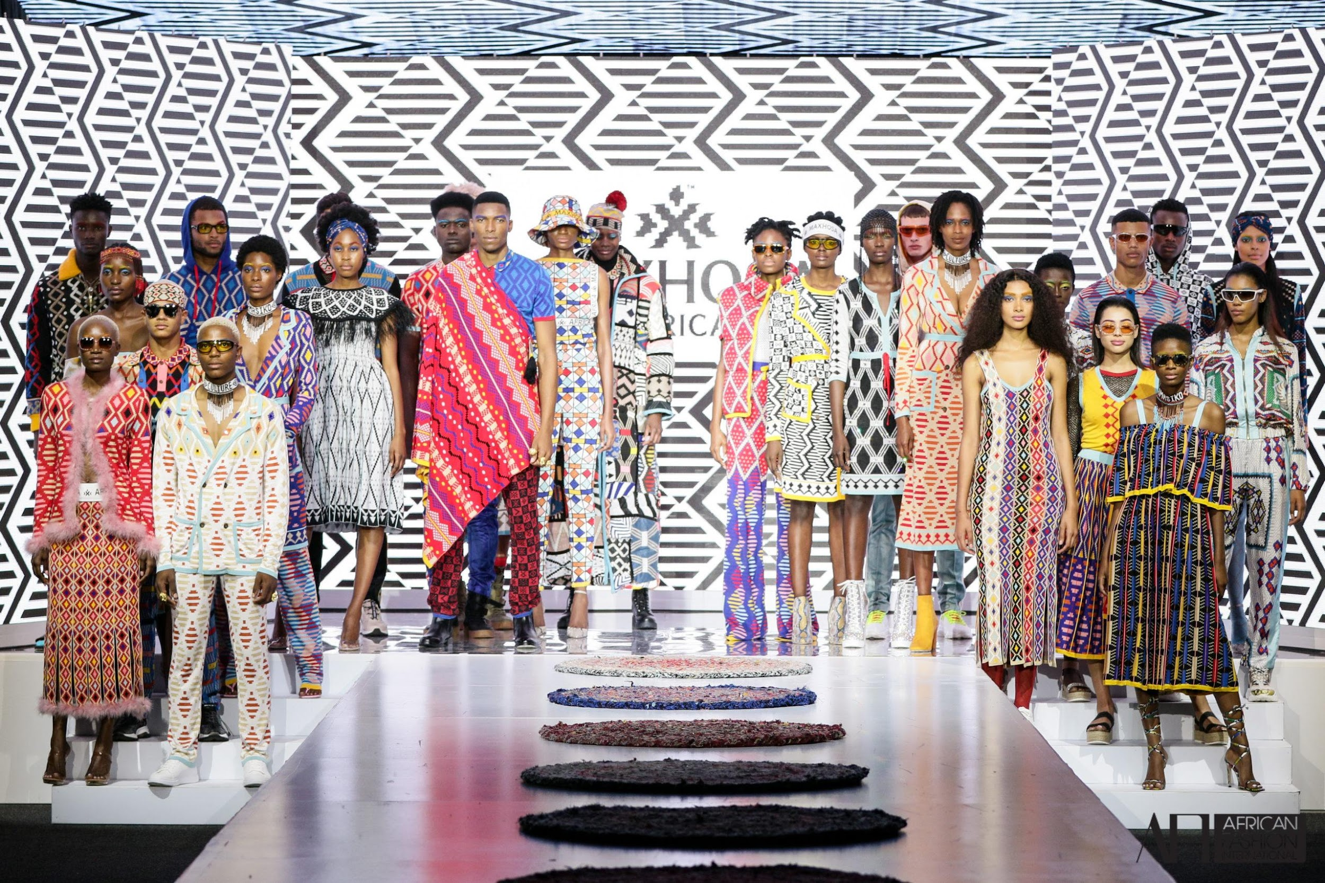
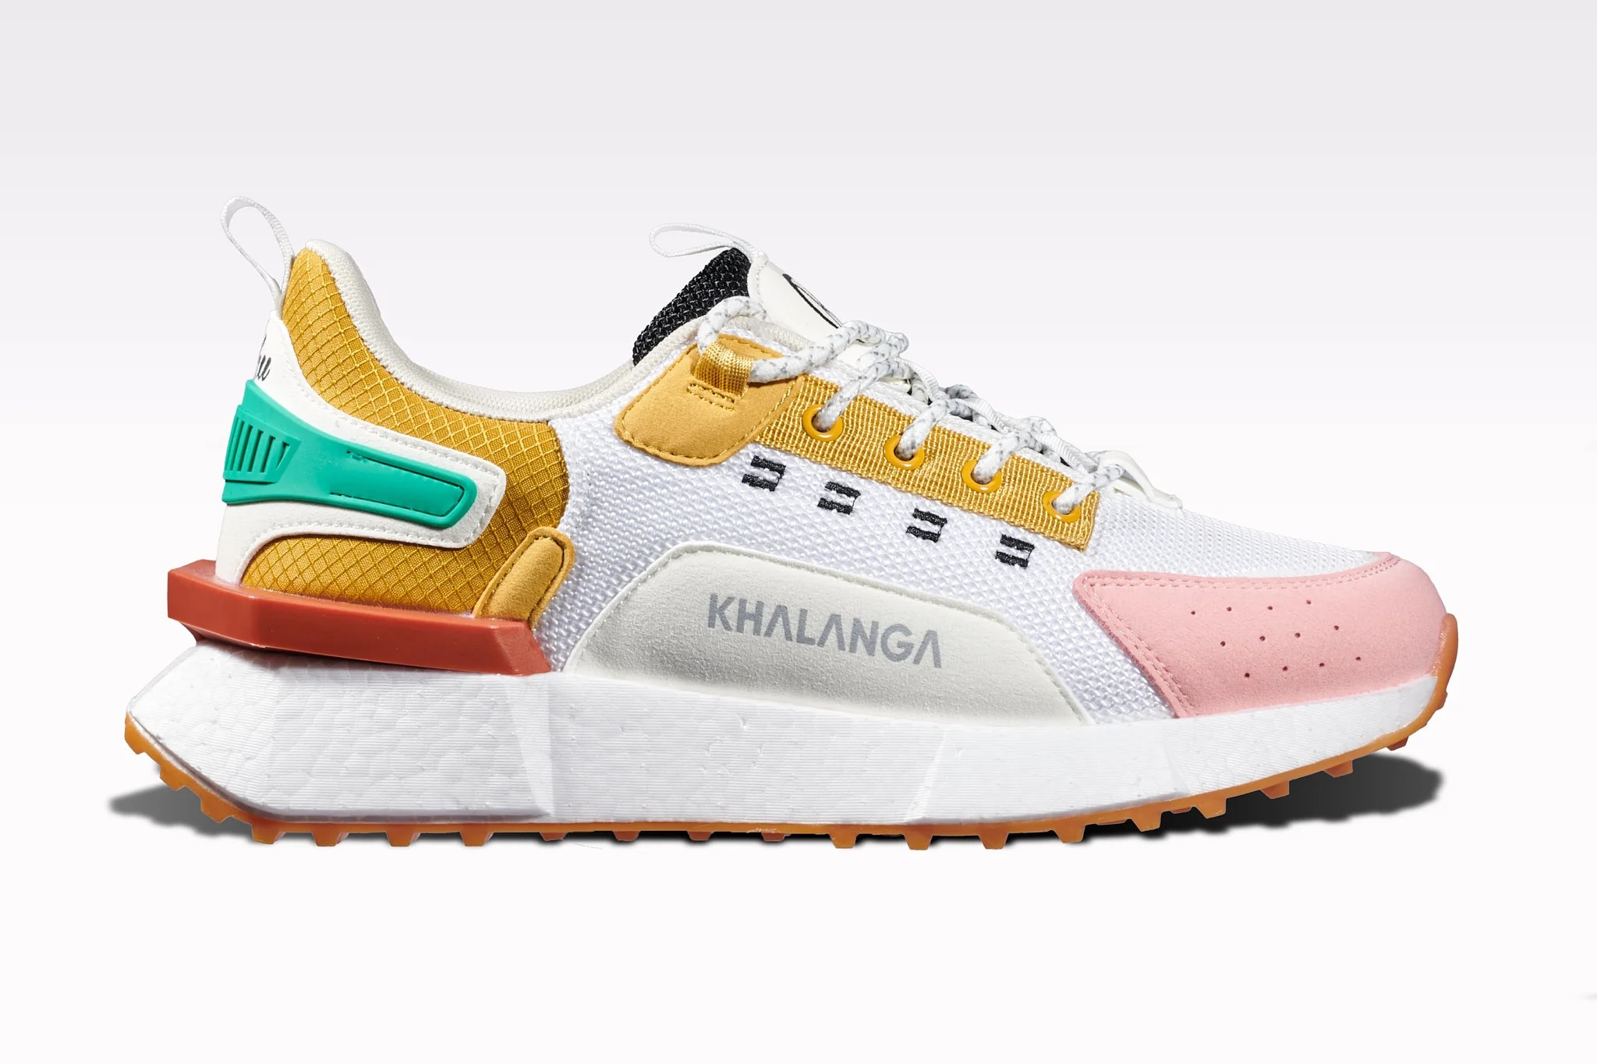

Slide 39
SUPPORTING TREVORS POSTS
Media drops will in various markets will be distributed around Trevors posts and each kit will tie in with the post from Trevor.
Each market (US, UK, Germany and South Africa) will be located 5 media drops to share with their media and or influencers.

Slide 40
ROLL OUT OVERVIEW
PHASE 1:
LAUNCH
PHASE 2:
MEDIA ENGAGEMENT
PHASE 3:
MEDIA DROP
The Best of Us:
Launch event with correspondent media
In- Market Media kit
Content guide for media with written content and visual assets for amplification
The Best of Us Box
Media drops will in various markets will be distributed around Trevors posts and each kit will tie in with the post from Trevor

Slide 41
ROI & METRICS OF MEASUREMENTS
AVE on media
Partnership value
Sentiment checks
Social listening
General measure:
1:3

Slide 42
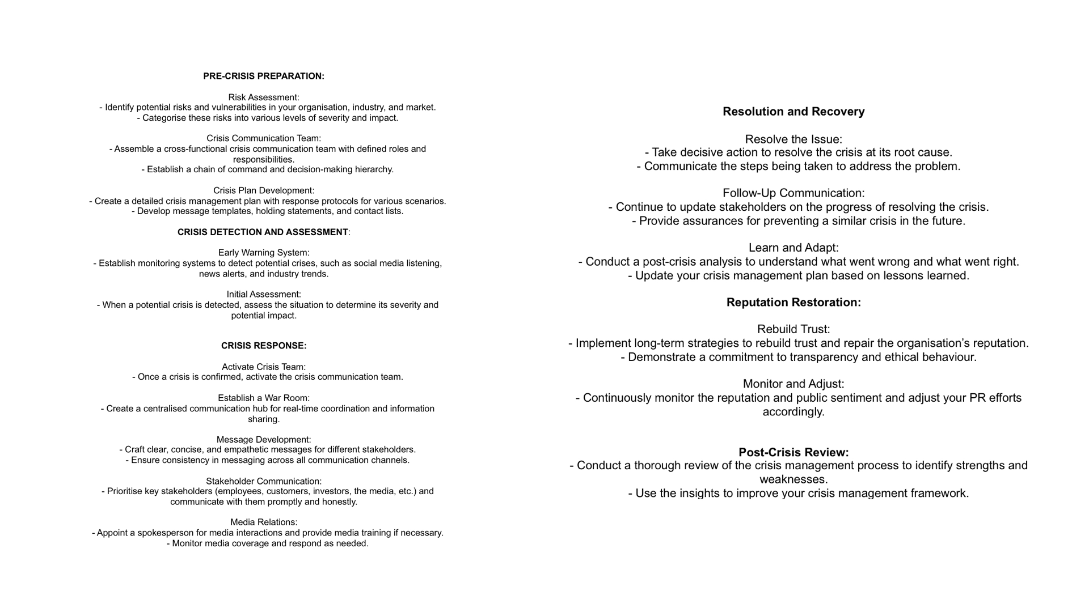
CRISIS MANAGEMENT

Slide 43
Thank you for your time
Digital media & PR

